Slide 1
MERCURY CONTROL
STAYING ONE STEP AHEAD

Slide 2
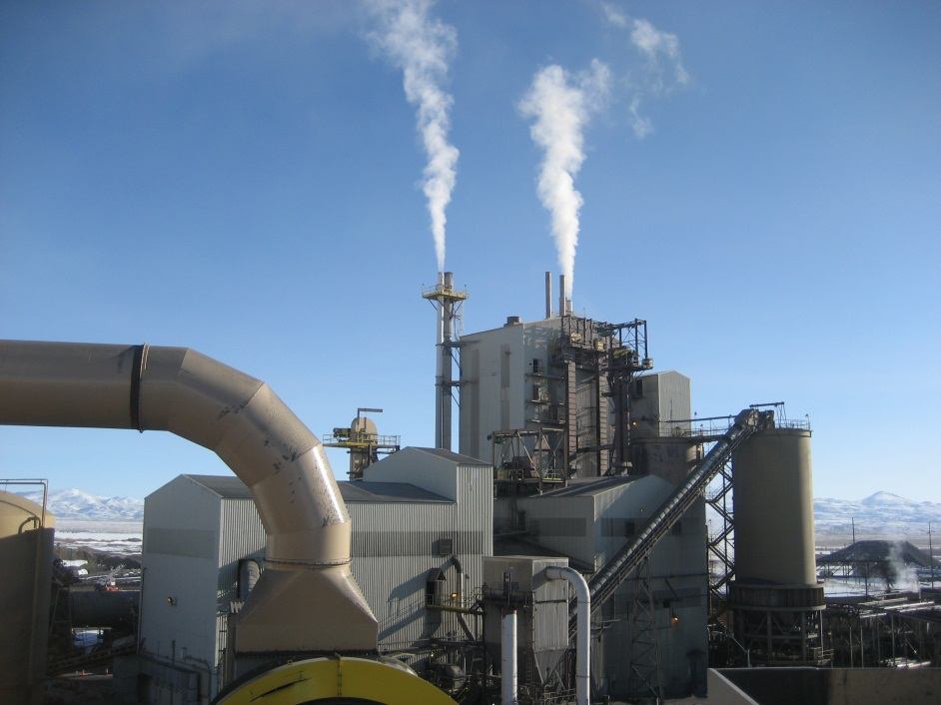
Technology
NouHgt Technologies has the exclusive rights to license and use the state of the art Mercury Control and Recovery technology patented by Celec Inc.
The technology is applicable in many areas however an important application is the removal of mercury from Natural Gas prior to compression and liquefaction.
Jerritt Canyon Mine twin roasting facility, Elko Nevada.
2

Slide 3
Natural Gas Fields I
Mercury is present in all of the world’s natural gas fields.
Process plants including liquefied natural gas (LNG) facilities and nitrogen-rejection facilities are susceptible to corrosive attack by mercury.
Mercury can cause severe and catastrophic corrosion of aluminum heat exchangers by liquid metal embrittlement (LME).
Target limits of mercury concentration in natural gas entering these plants is set at 10ng/Nm³.
NouHgt Technologies LLC. has the proven best technology to deal with mercury in natural gas.
3

Slide 4
Natural Gas Fields II
The concentration of mercury in the natural gas fields in Southeast Asia can be as high as 2,000 µg/Nm3.
4

Slide 5
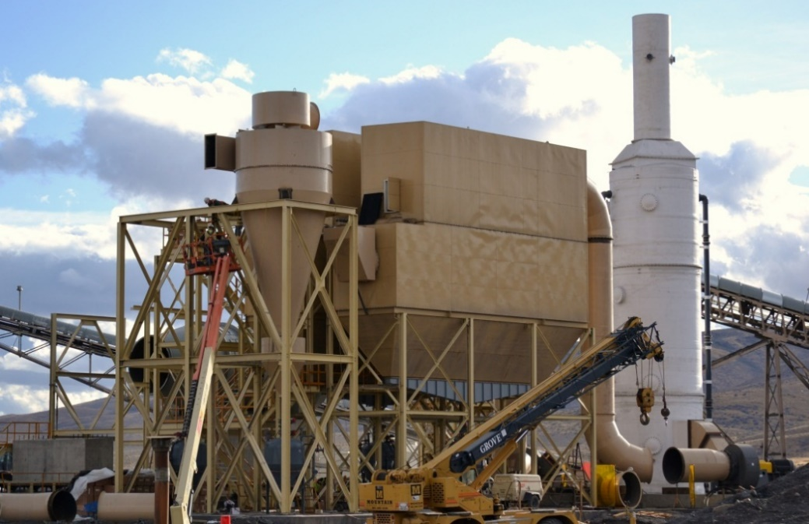
Corporate Strategy for Natural Gas I
Install Mercury control equipment in a Natural Gas liquefaction plant to allow it to meet technical specifications.
Constructing new ore dryer with mercury scrubbing stack, Jerritt Canyon Mine, Elko, Nevada
5

Slide 6
Contact
Contact Information:
Graham C. Dickson
President, CEO
Cell. 604 833 0346
graham@nouhgt.com
#304A 106 West 1st Street,
North Vancouver, BC
V7M 1A9
6

